Slide 2
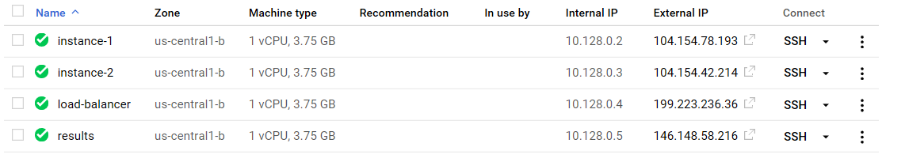
Homework #8
I was successfully able to add two VM instances both with dynamic data and a third instance for a load balancer

Slide 3
Start apache on each instance
Install Apache
Sudo apt-get install apache2
Start web server on each instance
Sudo /etc/init.d/apache2 start
(Note: To stop the replace ‘start’ with stop)

Slide 4
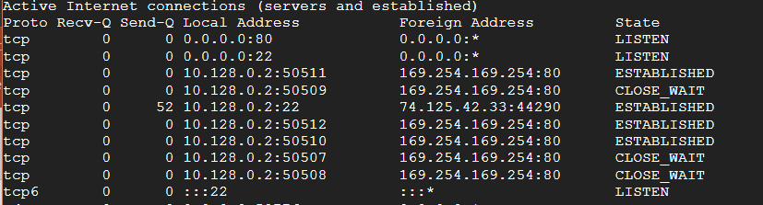
Check if webserver started
Netstat –an | more
Port :80 should be in listen state

Slide 5
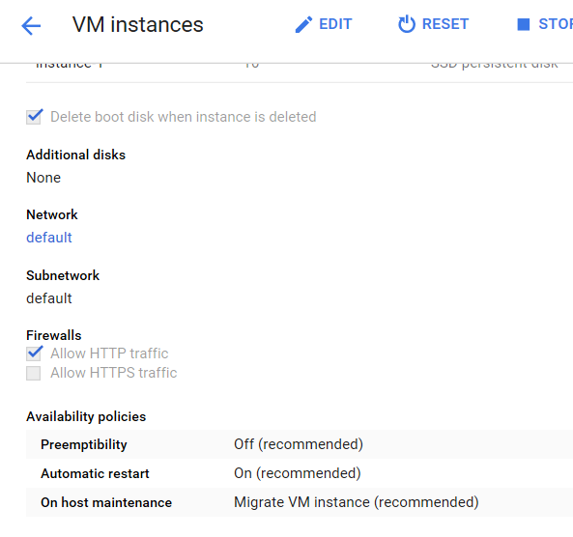
If port is not open check firewall settings in your GCE instance
To check if the port is open, the command nc –z yourIP 80
If it hangs then port is not open, if it returns nothing then port is open

Slide 6
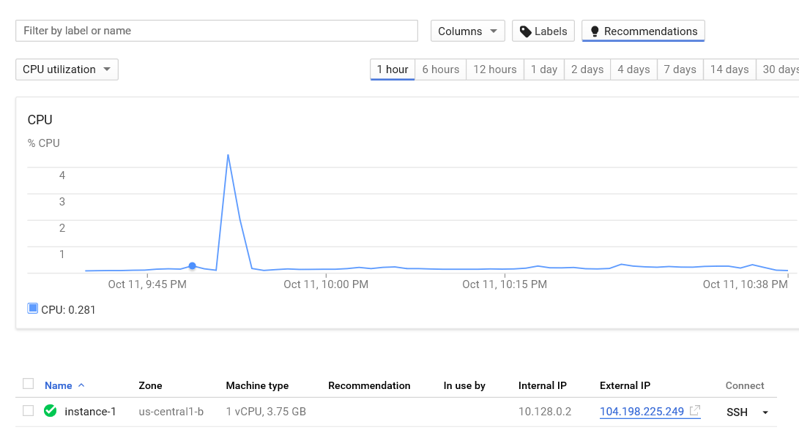
Capture external IP and fetch website from browser

Slide 7
Add html code for each apache instance
Echo “hello instance #” > /var/www/html/index.html for each instance replacing # with instance number

Slide 8
Intall apache on load balancer instance and configure for load balancing
Assume apache already installed
Install php
Apt –y install php libapache2-mod-php
Install modules
A2enmod proxy
A2enmod proxy_http
A23nmod proxy_balancer
A2enmod proxy_html

Slide 9
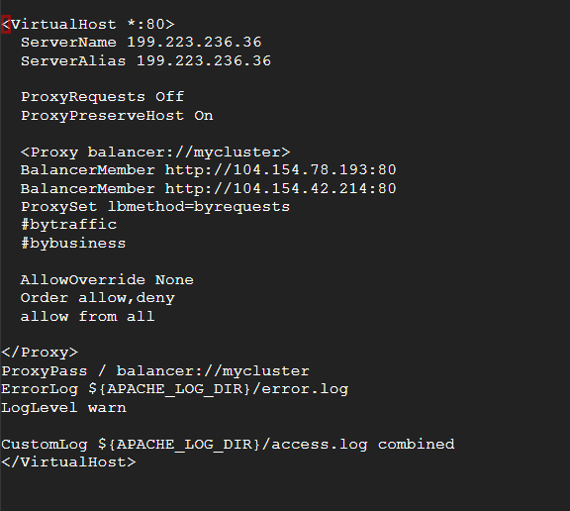
Modify load balance config file
Cd /etc/apache2/sites-available
Edit file 000-default.conf
Also add servername localhost to apache.conf file in /etc/apache

Slide 10
Key settings
Set balance members to the ip address of each instance that are not the load balancer
Set balance type accordingly
I chose by requests to toggle between each server per request
Every user call to load balancer server, load balancer switches which apache server to serve from

Slide 11
Activate load balancer
IF errors, run the command below and review /var/apache2/errors.log
Systemctl status apache2.service
Restart apache
Service apache2 restart

Slide 12
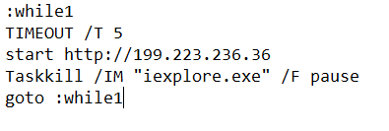
Induce web traffic on server
Created and call batch script to create web traffic and see and the servers handle

